Slide 1
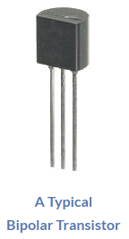
Bipolar Transistor The Bipolar Junction Transistor is a semiconductor device which can be used for switching or amplification. In the diode tutorials we saw that simple diodes are made up from two pieces of semiconductor material to form a simple pn-junction and we also learnt about their properties and characteristics. If we now join together two individual signal diodes back-to-back, this will give us two PN-junctions connected together in series that share a common P or N terminal. The fusion of these two diodes produces a three layer, two junction, three terminal device forming the basis of a Bipolar Junction Transistor, or BJT for short.

Slide 2
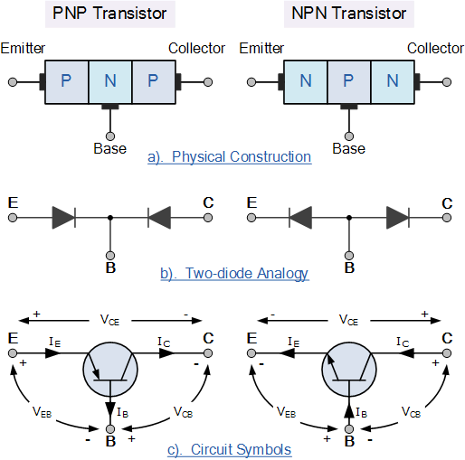
Transistors are three terminal active devices made from different semiconductor materials that can act as either an insulator or a conductor by the application of a small signal voltage. The transistor’s ability to change between these two states enables it to have two basic functions: “switching” (digital electronics) or “amplification” (analogue electronics). Then bipolar transistors have the ability to operate within three different regions: Active Region – the transistor operates as an amplifier and Ic = β*Ib Saturation – the transistor is “Fully-ON” operating as a switch and Ic = I(saturation) Cut-off – the transistor is “Fully-OFF” operating as a switch and Ic = 0

Slide 3
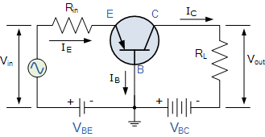
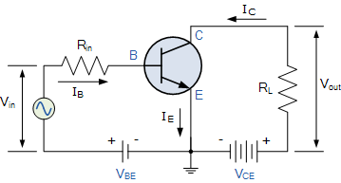
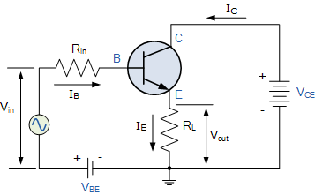
Bipolar Transistor Configurations As the Bipolar Transistor is a three terminal device, there are basically three possible ways to connect it within an electronic circuit with one terminal being common to both the input and output. Each method of connection responding differently to its input signal within a circuit as the static characteristics of the transistor vary with each circuit arrangement. Common Base Configuration – has Voltage Gain but no Current Gain. Common Emitter Configuration – has both Current and Voltage Gain. Common Collector Configuration – has Current Gain but no Voltage Gain. Common Base Common Emitter Common Collector

Slide 4
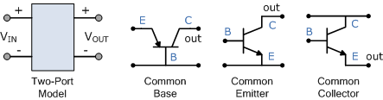
Bipolar Transistor Configurations
Characteristic | Common Base | Common Emitter | Common Collector
Input Impedance | Low | Medium | High
Output Impedance | Very High | High | Low
Phase Shift | 0º | 180º | 0º
Voltage Gain | High | Medium | Low
Current Gain | Low | Medium | High
Power Gain | Low | Very High | Medium

